Slide 1

Acuity Data and Tech services proposal for Peel Hunt
Optimizing Python code and Azure DevOps setup for rapid data processing and AI insights
February 2024

Slide 2

Proposal
01

Slide 3
Snapshot of Peel Hunt’s current requirements and solution
Acuity possesses the expertise to provide strong Data and Tech resources for Peel Hunt.
Background
The Head of Research Production is seeking to enhance and scale their existing AI/LLM framework and platform, beginning with a focused short-term project aimed at optimizing the Python LLM code and Azure DevOps setup.
1
Current Scope
Peel Hunt’s current scope is to enhance their Python code and Azure DevOps framework, accelerating data process efficiency and results delivery.
2
Solution
To address the immediate bottleneck, Acuity can deploy either 1 Python Data Scientist and 1 Azure DevOps Engineer - on a flexible 1 to 2-month timeline. This approach will optimize the Python code and Azure DevOps setup, setting a foundation for accelerating data processes and preparing for upcoming enhancement projects.
3
Timeline
Contractual documentation can be completed in approximately 8-10 days. Hiring and deployment will be completed in 8-10 weeks from commencement.
4
Important note
Acuity recommends a 2-month timeline for full optimization, with progress in 1-month. Initially working with blob storage, Acuity suggests to eventually leverage Databricks for analytics, and consider a transition in the future to datastores such as Azure Data Lake or Cosmos DB for enhanced scalability and data management.
5

Slide 4
Indicative timeline: highlights of the engagement and illustrative tasks
The timelines are estimations based on typical engagements, the actual data sets and current architecture set up will determine exact timelines
Phase 1 (2 weeks)
Phase 2 (1-3 weeks)
Phase 3 (1-3 weeks)
On-going
Code & DevOps Refinement
Log Analysis & Optimization
Optimization Implementation
Support & Future Projects
1 Python Data Scientist: Refactor and test code, add logging.
1 Azure DevOps Engineer: Optimize YAML and architecture.
1 Python Data Scientist: Analyze logs, experiment with optimization strategies.
1 Azure DevOps Engineer: Identify issues, troubleshoot problems and improve performance
1 Python Data Scientist: Implement chosen optimization solutions.
1 Azure DevOps Engineer: Streamlining workflows, enhancing resource utilization and refining processes to boost overall efficiency.
1 Python Data Scientist: Work on new data and AI/ML enhancement projects.
1 Azure DevOps Engineer: Support infrastructure, prepare for future scalability and enhancements.
Note: Acuity recommends a 2-month timeline for full optimization, with implementation progress shown in 1-month.

Slide 5



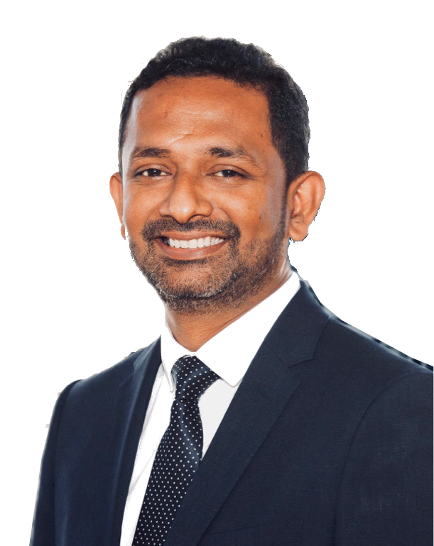




Indicative Operating model of the Acuity team for Peel Hunt
The data science and technology resources for Peel Hunt will be supported by CoE senior subject matter experts
Governance
Sanjay Kishnani
Sales & Business Development
Deepak Stephen
Head of Data Science Service Delivery Oversight
Venkatesh VK
Head of Tech
Service Delivery Oversight
Acuity Data and Tech Team for Peel Hunt
Usman Ahmad
Chief Data Scientist
Technical Delivery Oversight
Python Data Scientist
Azure DevOps Engineer
Manoj Fernando
Chief Data Architect
Technical Delivery Oversight
Python Code Refactoring and Logging
Log Analysis and Optimization
Optimization Implementation
Azure DevOps optimization

Slide 6
Indicative Commercials
02

Slide 7
Indicative commercials for the requirement
Indicative commercials for building an AI-powered search engine and on-going annual support
Role | Level | No. Years Experience | No. FTEs | Cost p.a. | 1-Month Cost | 2-Month Cost
Python Data Scientist | Senior Associate | 4-6 years | 1 | 88,320 | 7,360 | 14,720
Azure DevOps Engineer | Delivery Lead | 6-8 years | 1 | 77,760 | 6,480 | 12,960
Supervisor (Lead Data Scientist with Cloud experience) | Delivery Manager | 8+ years | 0.2 | 27,000 | 2,250 | 4,500
Total |  |  | 2.2 | 193,080 | 16,090 | 32,180
General notes on costs
A designated supervisor will allocate 10% of their capacity to oversee and support each FTE resource. Their responsibilities will include providing technical assistance and project management
Peel Hunt will be responsible for acquiring any necessary licenses and subscriptions to access public data sources. The Acuity team will undertake the task of identifying these data sources, with the final selection to be approved by the client during the data discovery stage of the project
The above rates do not include any costs related to software license, data license, data download and dedicated IT infrastructure Acuity may have to incur during the engagement. Acuity will seek prior approval before incurring such costs
The above price does not include incidentals like travel, accommodation and per diem cost for the duration Acuity team may visit client offices at the beginning of the project or as required. Acuity shall take prior approval before incurring such costs

